Slide 1
A robust Ensemble Learning Approach for Early Paddy Rice Prediction
Data Engineering and Analytics – Majwega Jackson
From farm inputs and climate to a working prediction tool
2,789
7
99.2%
826 kg
farms analysed
models compared
best R² score
best RMSE
Final Project — Majwega Jackson · April 2026
1 / 14

Slide 2
01 · PROJECT OVERVIEW
Why predict paddy yield?
THE GOAL
WHY IT MATTERS
OUR APPROACH
Forecast harvest size
Better farming decisions
Classical ML + Neural Net
Predict total paddy yield (in kg) for a farm before harvest, using only inputs and climate data already collected during the season.
Farmers, co-ops and extension officers can plan storage, pricing and input top-ups earlier — and spot under-performing plots before harvest.
We compare 5 classical models, 2 ensembles, and a neural network on the same test data, then recommend the model with the best accuracy and stability.
Paddy Yield Prediction · Final Project — Majwega Jackson
2 / 14

Slide 3
02 · DATASET
What we worked with
2,789
Each row = one farm-season
Farm management
FARM RECORDS
Hectares, Variety, Soil type, Nursery type, Agriblock (location)
68
Inputs applied
Seed rate, DAP, Urea, Potash, Micronutrients, Pesticide, Land prep, Weed control
RAW VARIABLES
Climate (4 growth windows)
4 × 30d
Rainfall · Min/Max temperature · Relative humidity — measured at D1–30, D31–60, D61–90, D91–120
Target variable
CLIMATE WINDOWS PER FARM
Paddy yield in kilograms — mean 22,518 kg, range 5,410 – 38,814 kg
Paddy Yield Prediction · Final Project — Majwega Jackson
3 / 14

Slide 4
03 · FEATURE ENGINEERING
Turning raw numbers into useful signals
Raw totals (e.g. total kg of urea) just track farm size. We re-expressed every input as a per-hectare rate so the model could learn the difference between under-, optimal, and over-application.
1
Per-hectare ratios
2
Composite intensity
3
Climate aggregates
Nine input ratios — seed rate/ha, urea/ha, DAP/ha, potash/ha, micro/ha, pesticide/ha, land-prep/ha, nursery-prep/ha, weed-control/ha. Captures how intensely each plot is managed.
A single z-score that summarises overall input intensity across all 9 ratios. Lets the model spot ‘over-applied’ vs ‘under-applied’ farms instantly.
Across the 4 growth windows: mean rain, total rain, rain variability, mean min/max temperature, temperature range, mean and range of humidity.
Paddy Yield Prediction · Final Project — Majwega Jackson
4 / 14

Slide 5
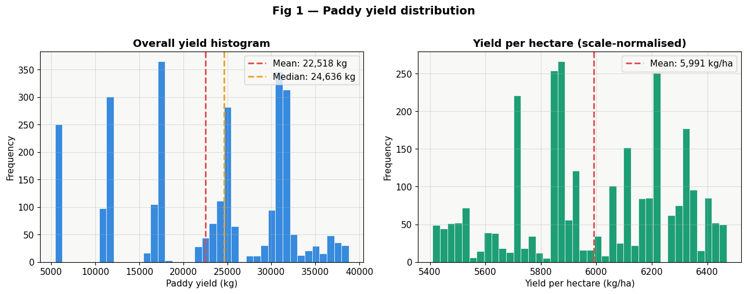
04 · EDA — UNIVARIATE
How much yield, and how does it spread?
WHAT THE PLOT SHOWS
Two shapes, one story
Total yield (left) ranges from 5.4 t to 38.8 t — wide, because farms are different sizes. Yield per hectare (right) is much tighter and bell-shaped, meaning per-acre productivity is fairly consistent. Implication: farm size drives most of the raw spread, so we model yield while controlling for hectares.
Paddy Yield Prediction · Final Project — Majwega Jackson
5 / 14

Slide 6
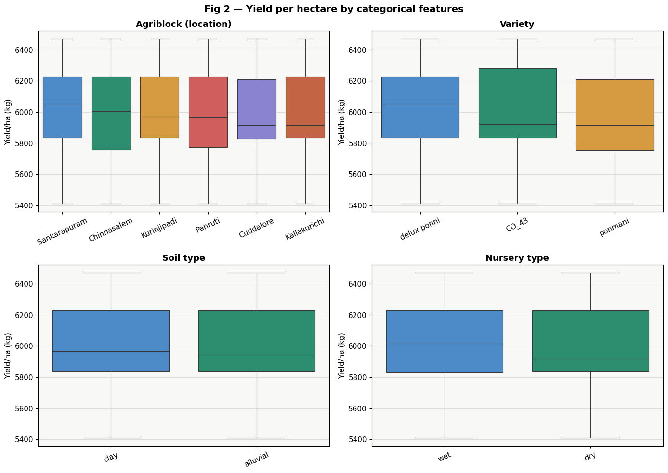
05 · EDA — MULTIVARIATE
Where do the yield differences come from?
READING THE BOXPLOTS
Place, variety & soil all matter
Agriblock (location): yield/ha clearly differs between blocks — geography sets a baseline. Variety: some seed varieties consistently out-yield others on the same land. Soil type: alluvial vs clay shifts the median noticeably. Nursery (wet vs dry): smaller effect, but still visible in the medians.
Takeaway: variety + location + soil collectively explain a big share of yield — strong features for the model.
Paddy Yield Prediction · Final Project — Majwega Jackson
6 / 14

Slide 7
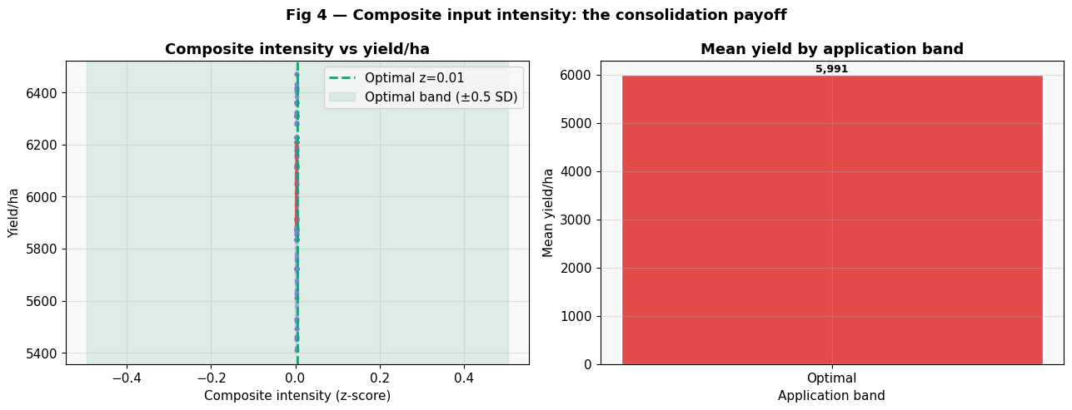
06 · EDA — INPUT INTENSITY
Is more input always better?
THE CONSOLIDATION PAYOFF
There's a sweet spot
The curve is shaped like an upside-down U. Yield rises with input intensity up to a peak, then drops.
Both under-applying and over-applying hurt yield. The model can therefore reward staying inside the optimal band.
VERY LOW / HIGH → yield drops
OPTIMAL BAND → peak yield
AT-RISK ZONES → actionable insight
Paddy Yield Prediction · Final Project — Majwega Jackson
7 / 14

Slide 8
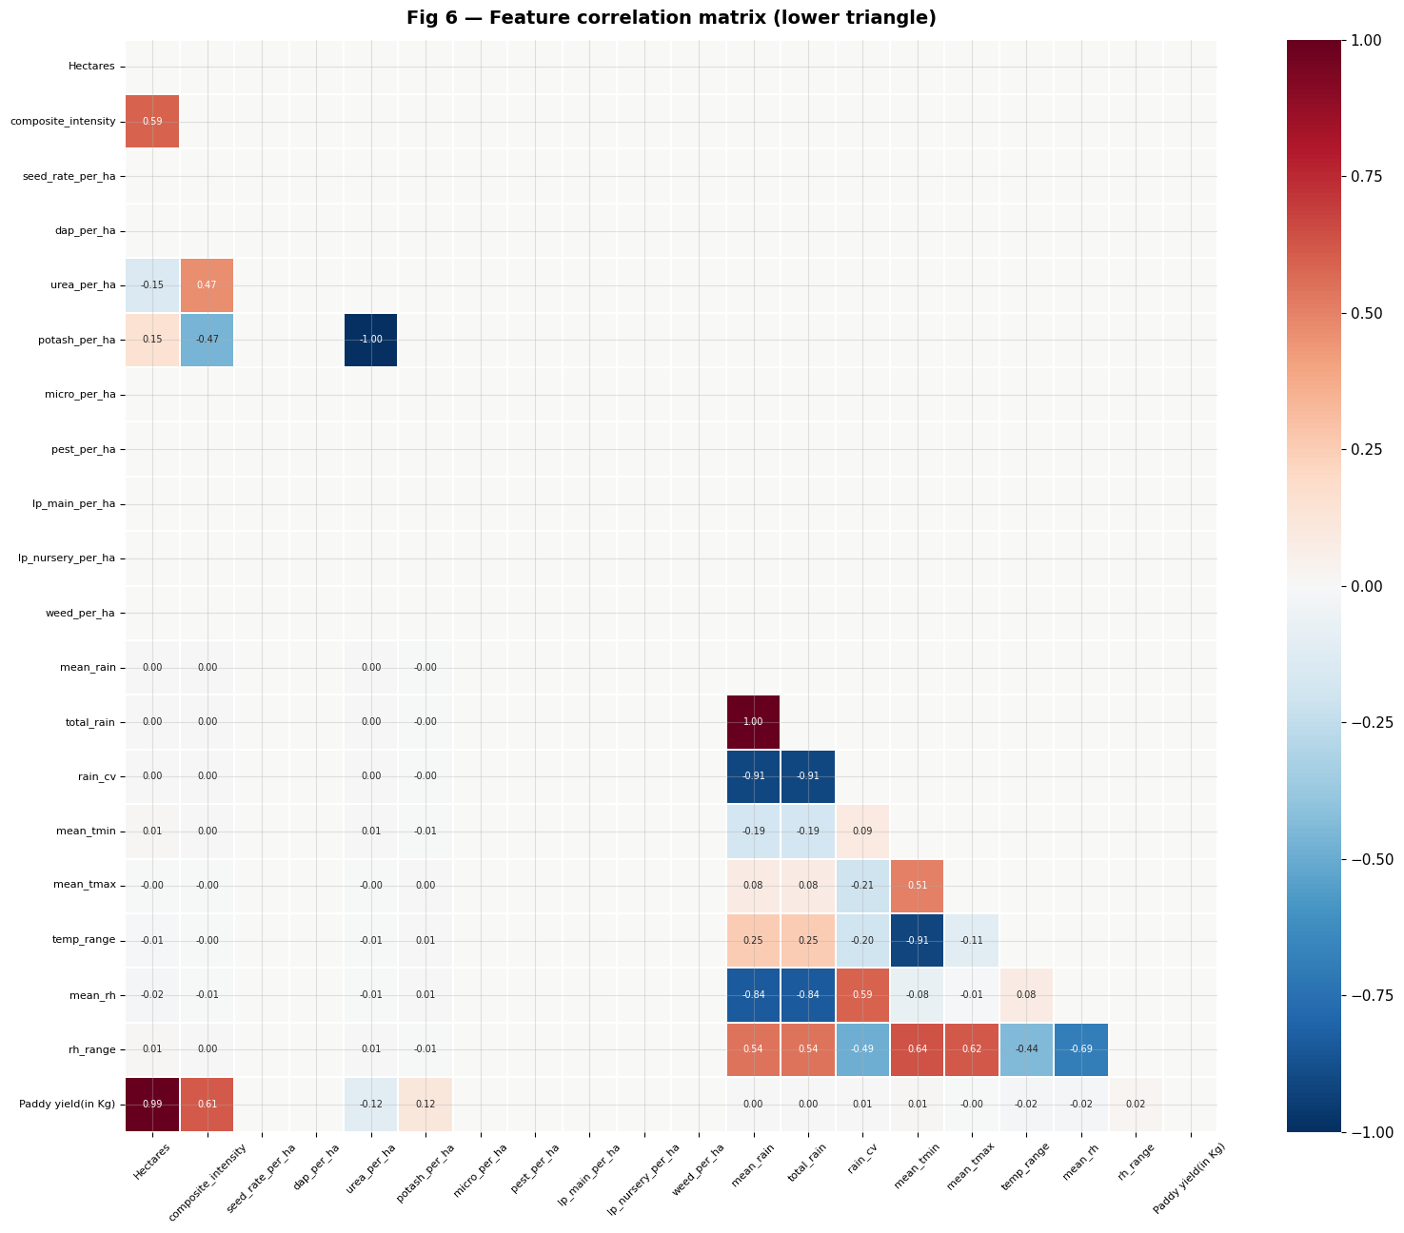
07 · EDA — FEATURE RELATIONSHIPS
How features connect to yield
READING THE HEATMAP
Hectares is the dominant driver
Blue cells = positive link. Red cells = negative link. Bigger numbers = stronger links.
Hectares
strongly predicts total yield — bigger farm, more rice.
Per-hectare ratios
cluster together — they share the consolidation signal.
Climate features
show weaker direct links — climate matters in combination with management, which non-linear models can capture.
Paddy Yield Prediction · Final Project — Majwega Jackson
8 / 14

Slide 9
08 · MODELING
Seven candidates, one fair test
Same 80/20 train/test split · same features · same seed (42) · 5-fold cross-validation on training data
CLASSICAL ML
ENSEMBLES
NEURAL NETWORK
Tree models & a baseline
Combine the best models
Multi-layer perceptron
Random Forest
Voting (RF + GB + ET)
3 hidden layers: 256 → 128 → 64
Gradient Boosting
Stacking (RF + GB + ET → Ridge)
ReLU activation, Adam optimiser
Extra Trees
Average vs learned blending
L2 regularisation + early stopping
Ridge regression (baseline)
5-fold cross-validation
Standard-scaled inputs
Paddy Yield Prediction · Final Project — Majwega Jackson
9 / 14

Slide 10
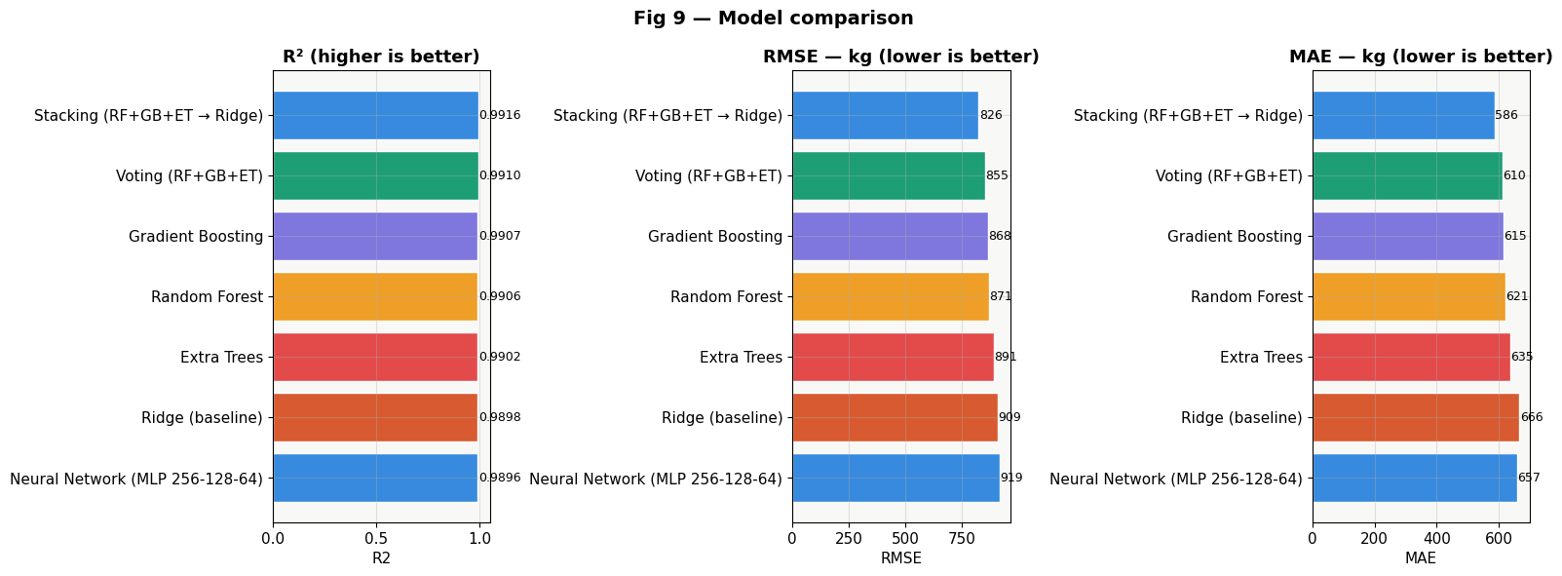
09 · RESULTS
How the seven models compare
RANKED BY R²
RANK
MODEL
R²
RMSE (kg)
1
Stacking (RF+GB+ET)
0.9916
826
2
Voting (RF+GB+ET)
0.9910
855
3
Gradient Boosting
0.9907
868
4
Random Forest
0.9906
871
5
Extra Trees
0.9902
891
6
Ridge (baseline)
0.9898
909
7
Neural Network MLP
0.9896
919
Stacking wins on every metric (R², RMSE, MAE, CV-R²). All tree-based models cluster tightly above 99% R² — the neural network is competitive but slightly behind, and the Ridge baseline shows the data is mostly linear.
Paddy Yield Prediction · Final Project — Majwega Jackson
10 / 14

Slide 11
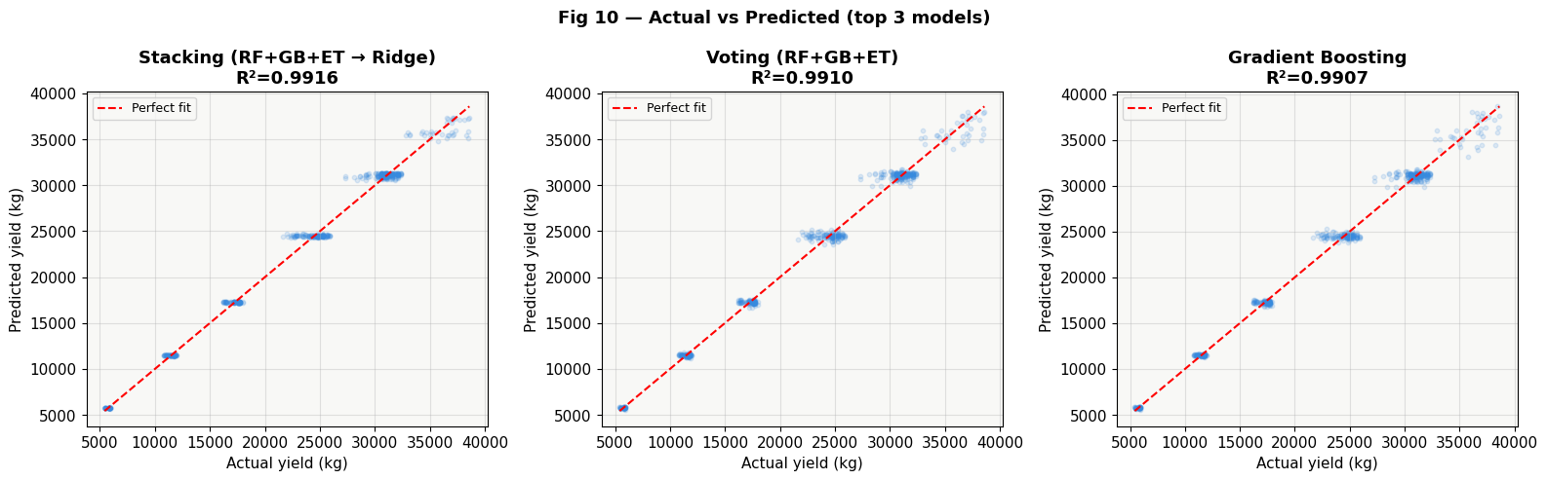
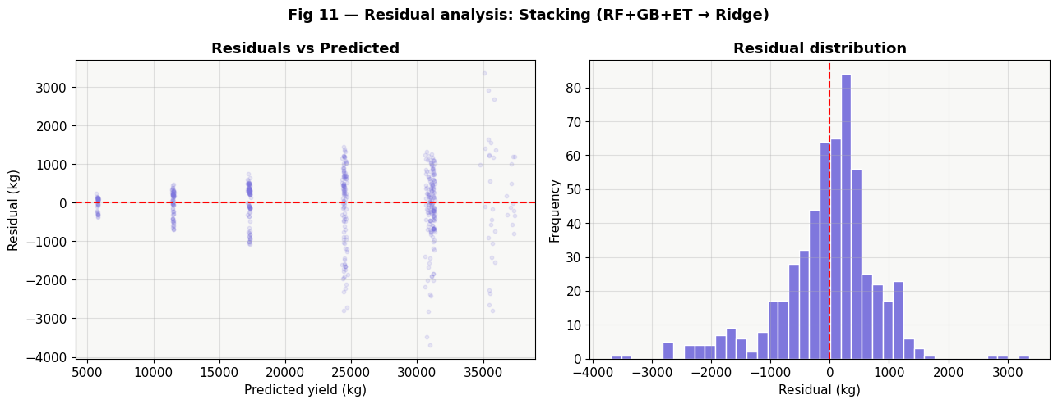
10 · DIAGNOSTICS
Does the winner agree with reality?
WHAT TO LOOK FOR
Tight, balanced, no bias
Top: actual vs predicted
Points hug the dashed line — predictions match reality across the full yield range.
Bottom: residuals
The error histogram is centred on zero and roughly symmetric — the model isn't systematically over- or under-predicting.
Average miss: ±586 kg per farm — about 2.6% of mean yield.
Paddy Yield Prediction · Final Project — Majwega Jackson
11 / 14

Slide 12
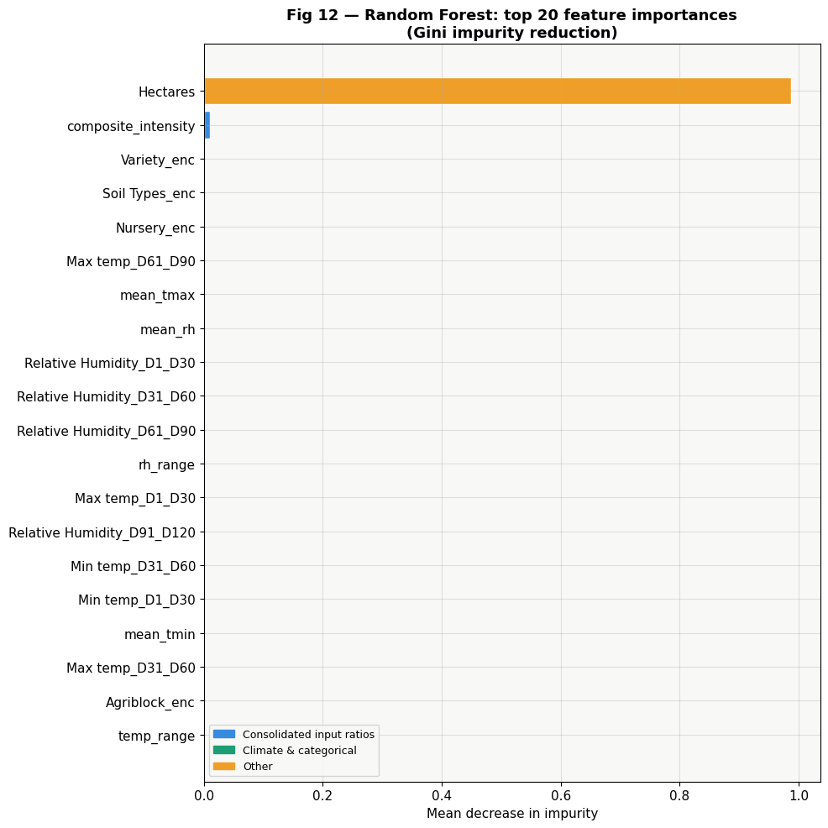
11 · EXPLAINABLE AI
What does the model say drives yield?
TOP DRIVERS OF YIELD
Size, then management, then climate
Hectares
Farm scale dominates total yield.
Per-hectare input ratios
How intensely fertiliser, seed and pesticide are applied.
Variety & Soil type
Choice of seed and growing medium.
Climate aggregates
Mean rainfall, temperature range and humidity.
Paddy Yield Prediction · Final Project — Majwega Jackson
12 / 14

Slide 13
12 · RECOMMENDATION
Use the Stacking ensemble in production
R² 0.9916
RMSE 826 kg
MAE 586 kg
CV-R² 0.9924
HIGHEST ACCURACY
LOWEST TYPICAL ERROR
LOWEST AVERAGE MISS
STABLE ACROSS FOLDS
Why Stacking wins
Combines complementary strengths
Random Forest, Gradient Boosting and Extra Trees each see different patterns; Stacking learns how to weight them.
Best on every metric
Top R², RMSE, MAE and cross-validated R² — not just one number, the whole scorecard.
Stable, not over-fit
Cross-validation matches test performance, so the lift is real, not luck.
Better than a neural net here
MLP underperforms on this size of structured tabular data — trees handle non-linear interactions better.
If a simpler, faster model is needed, Random Forest or Gradient Boosting alone still give R² ≈ 0.99 with one click of training.
13 / 14

Slide 14
13 · DEMO & CLOSING
From notebook to working tool
INTERACTIVE DEMO
Key takeaways
Built with Gradio
01
Per-hectare ratios reveal a real ‘sweet spot’ for inputs.
A user picks a farm's variety, soil, hectares and the planned input rates, and the app returns a predicted yield in kilograms.
The user can also switch between models on the fly — Stacking for accuracy, Random Forest for speed and explainability — and compare their predictions side by side.
Climate values for later growth windows default to the dataset means, so the tool works even at planting time.
02
Tree ensembles beat the neural network on structured farm data.
03
Stacking gives the best accuracy and stability — recommended.
04
The pipeline is ready to plug into a Gradio interface farmers can use.
Thank you — Majwega Jackson · Final Project, April 2026
14 / 14

